Slide 1
Processor Structure and Function

Slide 2
Processor Organization
Requirements placed on processor:
Fetch instruction
Interpret instruction
Fetch data
Process data
Write data

Slide 3
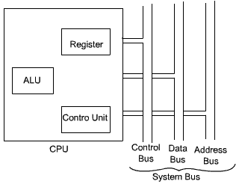
CPU with System Bus

Slide 4
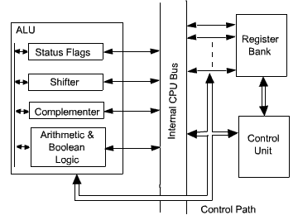
Internal Structure of CPU

Slide 5
Register Organization
Register roles in processor:
User-visible registers: Enables machine or assembly language programmer to minimize main memory references by optimizing use of registers
Control and Status registers: Used by control unit to control the operation of processor and by privileged, operating system programs to control the execution of programs

Slide 6
Register Organization
Register roles in processor:
User-visible registers
General-purpose registers
Address register
Control and Status registers
Program counter(PC)
Instruction register(IR)
Memory address register(MAR)
Memory buffer register(MBR)
Processor Status Word(PSW) – register set – status info

Slide 7
Instruction Cycle
Instruction Cycle – Stages:
Fetch
Execute
Interrupt
Indirect Cycle – Operands fetched using indirect addressing
Data Flow :
Fetch Cycle
Indirect Cycle
Interrupt Cycle

Slide 8
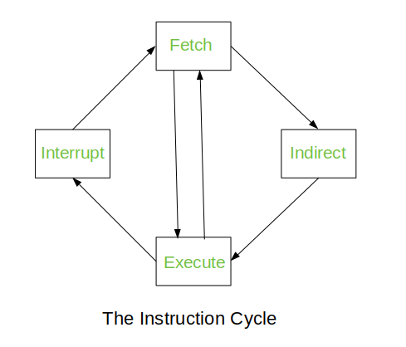
Indirect Cycle
Instruction Cycle:

Slide 9
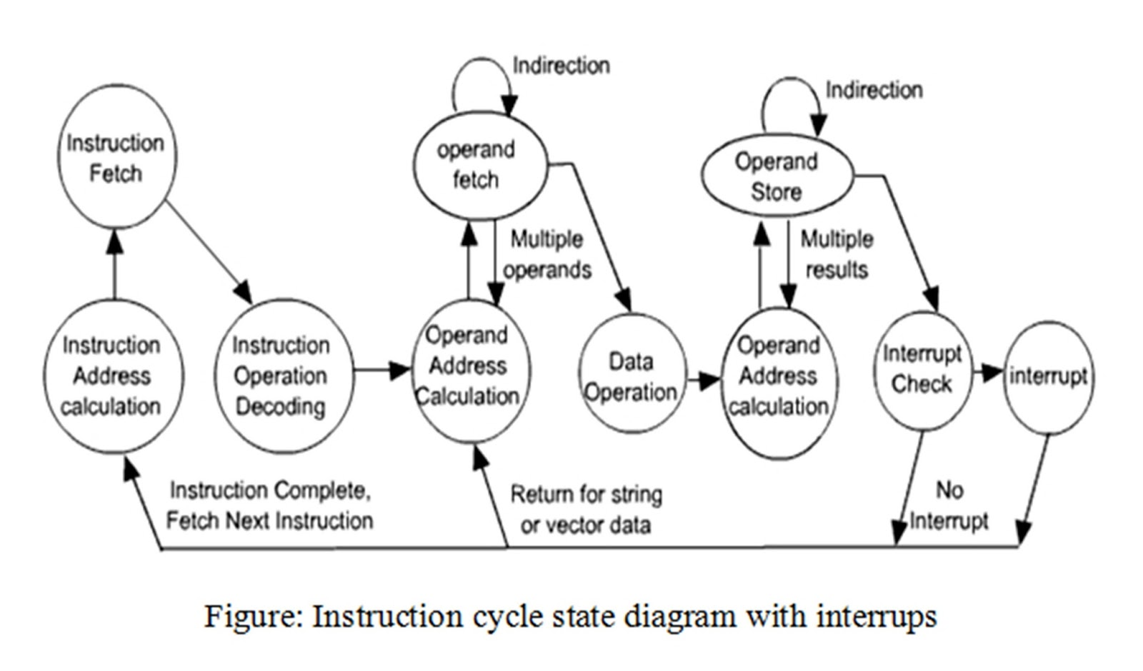
Instruction Cycle State Diagram

Slide 10
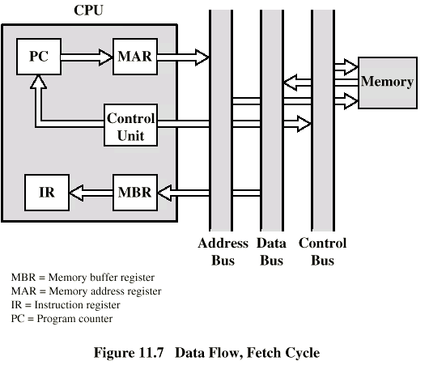
Data Flow, Fetch Cycle

Slide 11
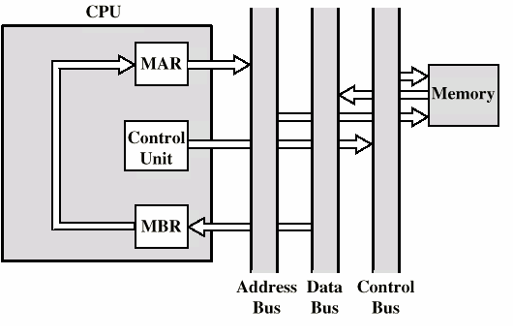
Data Flow, Indirect Cycle

Slide 12
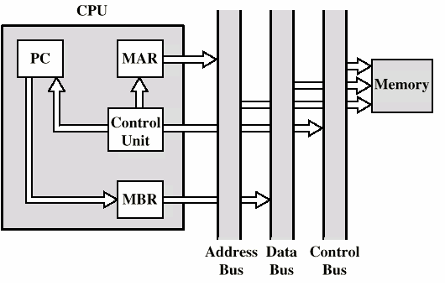
Data Flow, Interrupt Cycle

Slide 13
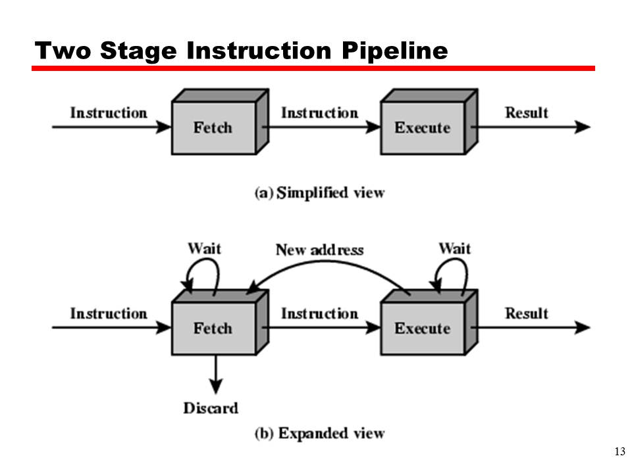
Instruction Pipelining
Pipelining is used by virtually all modern microprocessors to enhance performance by overlapping the execution of instruction

Slide 14
Pipeline Stages
Fetch instruction(FI)
Decode instruction(DI)
Calculate operands(CO)
Fetch operands(FO)
Execute instruction(EI)
Write operand(WO)

Slide 15
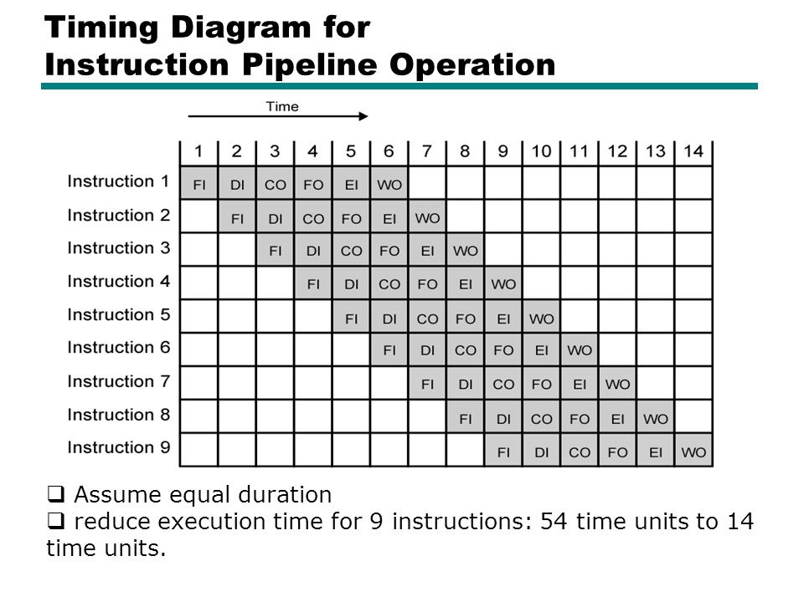

Slide 16
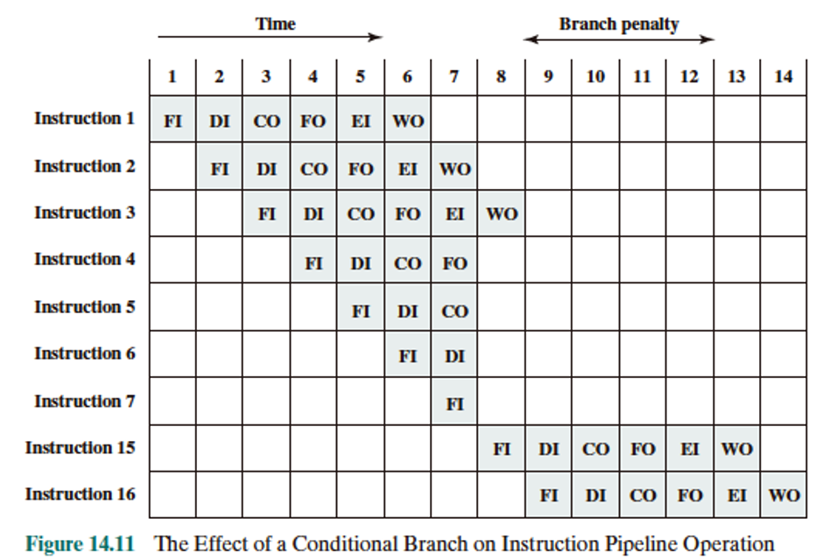

Slide 17
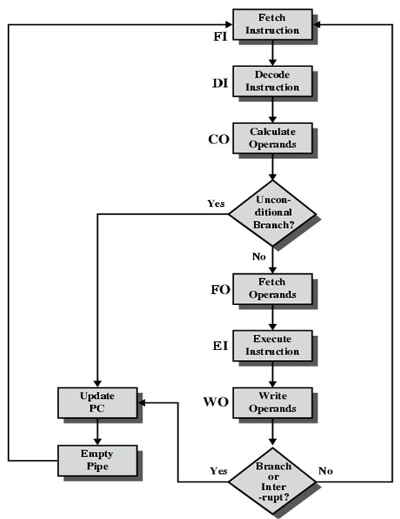
Six-Stage CPU Instruction Pipeline

Slide 18
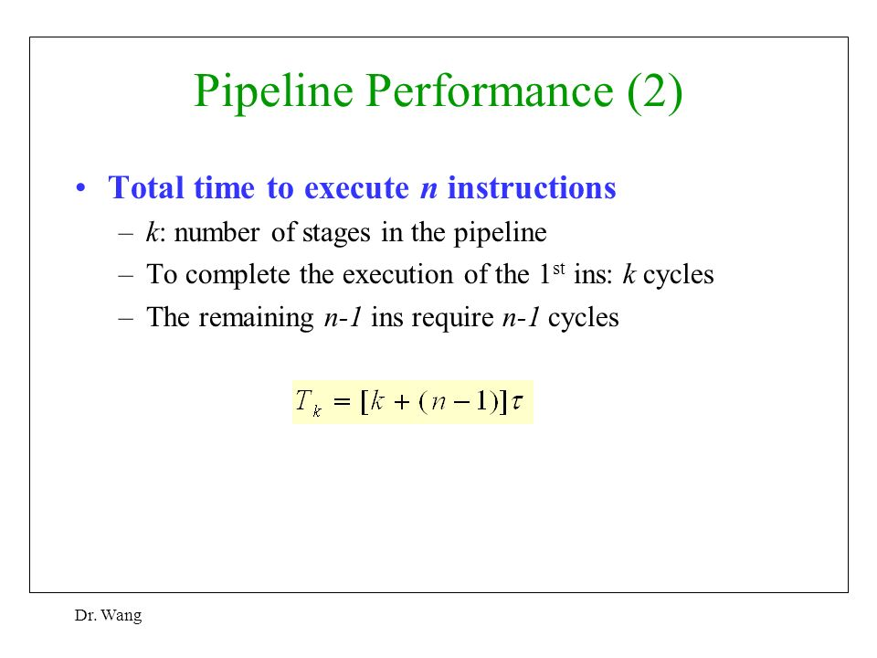

Slide 19
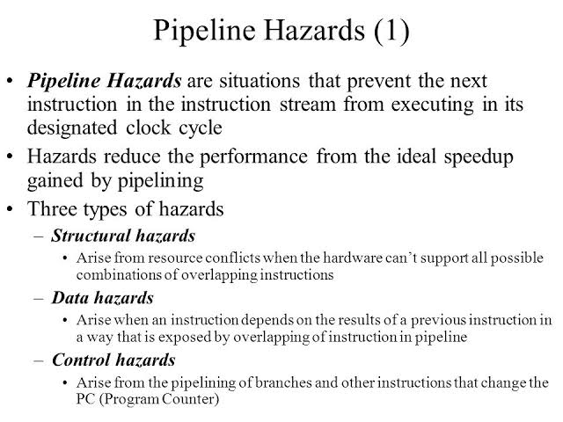

Slide 20
MICROPROGRAMMED CONTROL

Slide 21
Microprogrammed Control – Basic Concepts
1. Set of micro-operations occurring at one time – microinstruction.
2. Sequence of such instruction – microprogram or firmware.
3. For each micro-operation control unit generate set of control signals represented by a different pattern of 1s and 0s in control word.
4. Address field to each control word, indicate location of next control word to be executed if certain condition is true with few bits added to specify condition – Horizontal microinstruction.
5. Formate of microinstruction or control word is shown in figure.

Slide 22
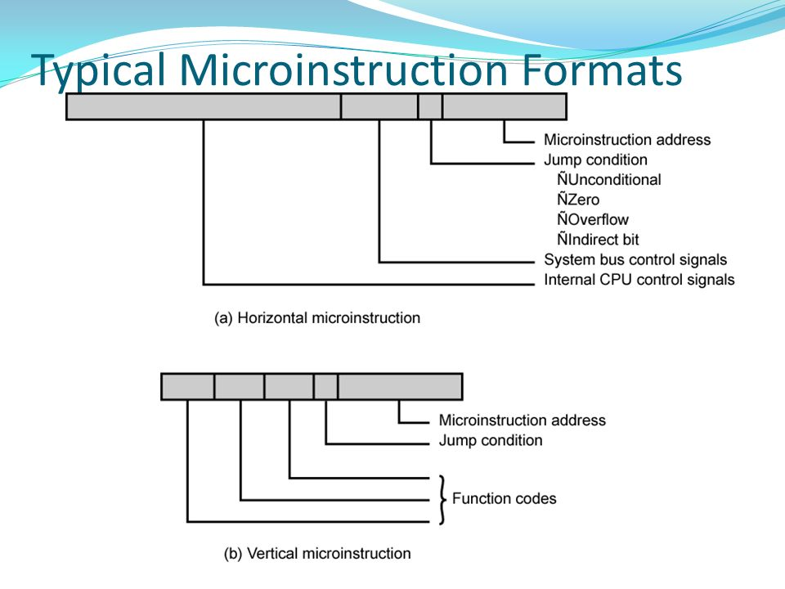

Slide 23
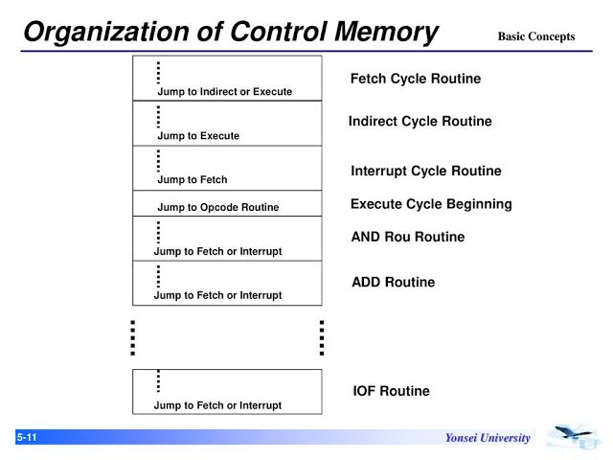
Arrangement of microinstruction in control memory

Slide 24
1. The microinstruction in each routine are to be executed sequentially.
2. Each routine ends with a branch or jump instruction indicating where to go next.
3. There is a special execute cycle routine that signify machine instruction routine(AND, ADD, and so on) to be executed next, depending on the current opcode.

Slide 25
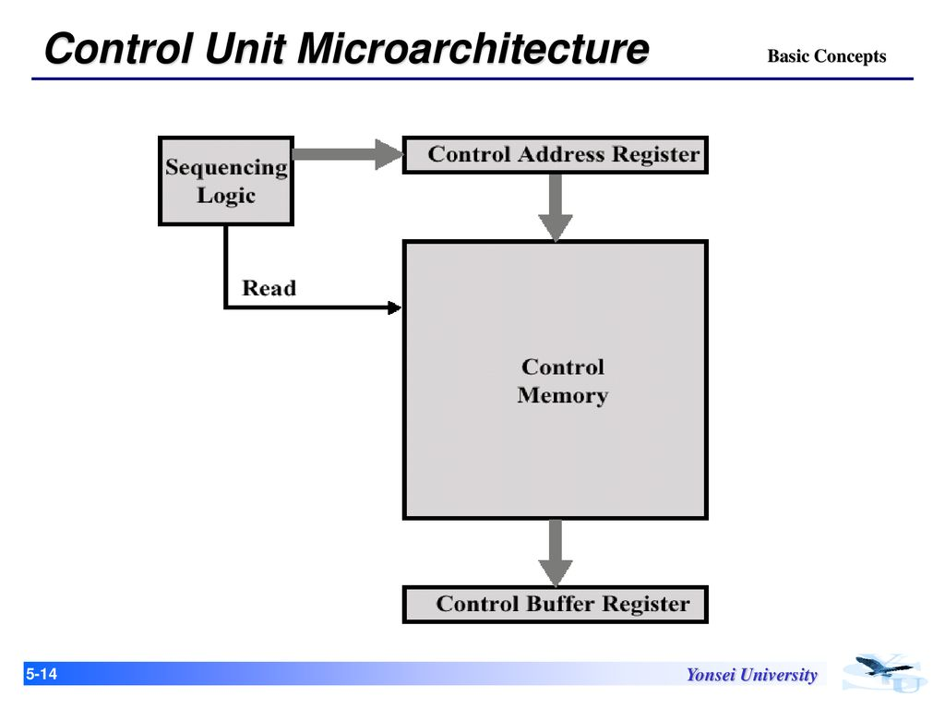
Microprogrammed Control Unit

Slide 26
Set of microinstruction is stored in control memory.
The control address register contains address of next instruction to be read.
When a microinstruction is read from control memory, its transferred to a control buffer register.
Reading a microinstruction from control memory is same as executing that microinstruction.
The third element is a sequencing unit that loads control address register and issues a read command.

Slide 27
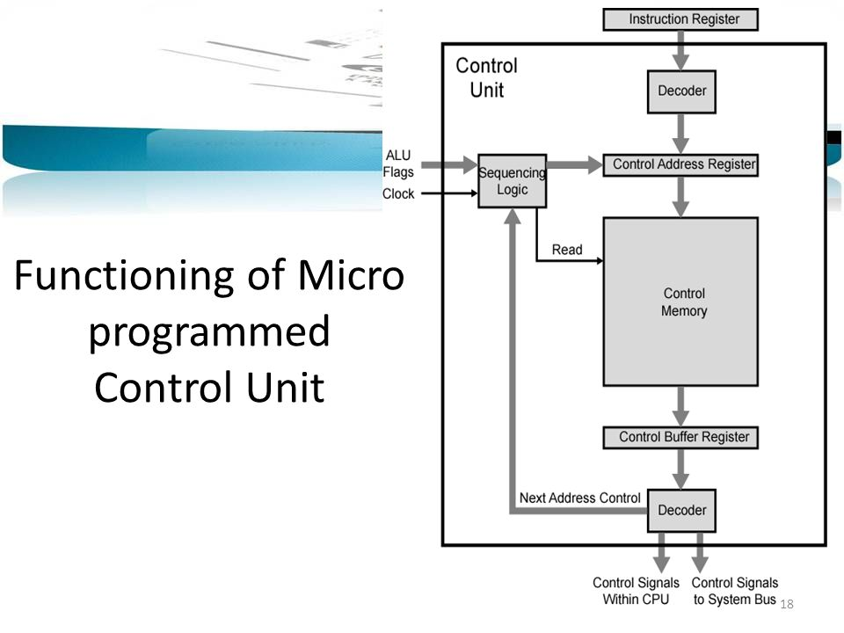

Slide 28
The control unit functions as follows:
To execute an instruction, the sequencing logic unit issues a READ command to control memory.
The word whose address is specified in the control address register is read into control buffer register.
The content of control buffer register generates control signals and next-address information for sequencing logic unit.
The sequencing logic unit loads a new address into control address register based on the next-address information from control buffer register and ALU flags.
Figure shows two modules labeled decoder. The upper decoder translates the opcode of IR into control memory address. The lower decoder used for vertical micrinstructions. In vertical microinstruction, a code is used for each action to be performed. The decoder translates this code into individual control signals.

Slide 29
MICROINSTRUCTION SEQUENCING
The two basic tasks performed by a microprogrammed control unit are as follows:
Microinstruction Sequencing: get the next microinstruction from the control memory.
Microinstruction Execution: generate the control signals needed to execute the microinstruction.
Design Considerations:
Size of microinstruction – reduce cost
Address-generation time – faster execution

Slide 30
In executing a microprogram, the address of the next microinstruction to be executed is in one of these categories:
Determined by instruction register
Next sequential address
Branch
Sequencing Techniques:
Branch Control Logic: Two Address Fields
Branch Control Logic: Single Address Fields
Branch Control Logic: Variable Format

Slide 31
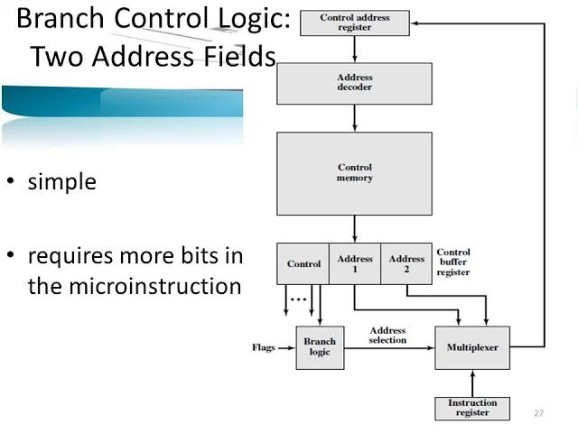

Slide 32
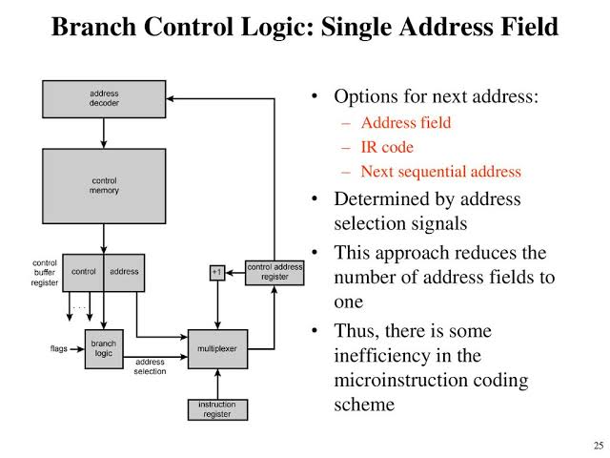

Slide 33
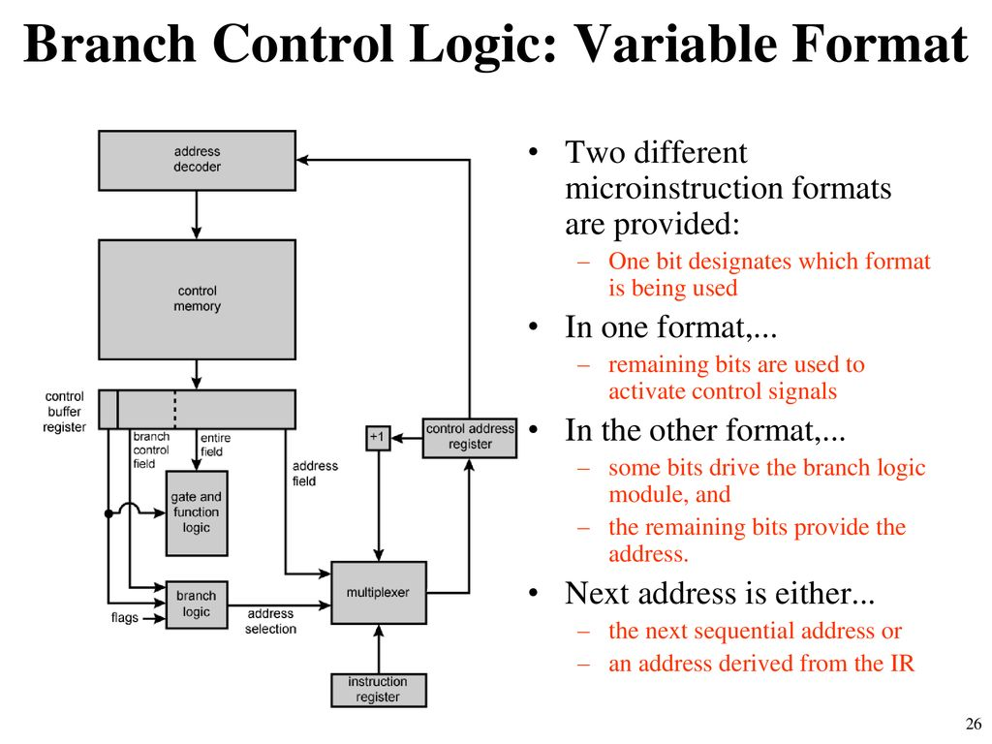

Slide 34
MICROINSTRUCTION EXECUTION
Execution of a microinstruction is to generate control signals.
The control logic module generates control signals as a function of some of the bits in the microinstruction.
It should be clear that the format and content of the microinstruction determines the complexity of the control logic module.
Microinstruction classified in many ways. All of these bear on format of microinstruction. Distinctions include the following:
i. Vertical/horizontal
ii. Packed/unpacked
iii. Hard/soft microprogramming
iv. Direct/indirect encoding

Slide 35
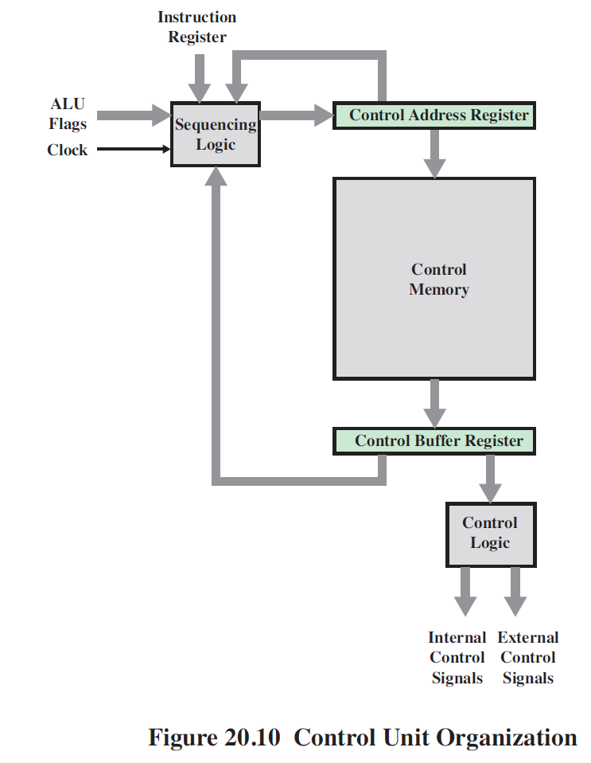

Slide 36
Microinstruction Encoding:
Functional encoding
Resource encoding
Direct encoding
Indirect encoding
Functional Encoding – designates fields by function type.
Resource Encoding – devotes one field to each
independent resource.
Direct Encoding – microinstruction organized as fields containing code, which upon decoding activates control signals.
Indirect Encoding – one field used to determine interpretation of another field. These implies two level of decoding, increasing propagation delay.

